Slide 1
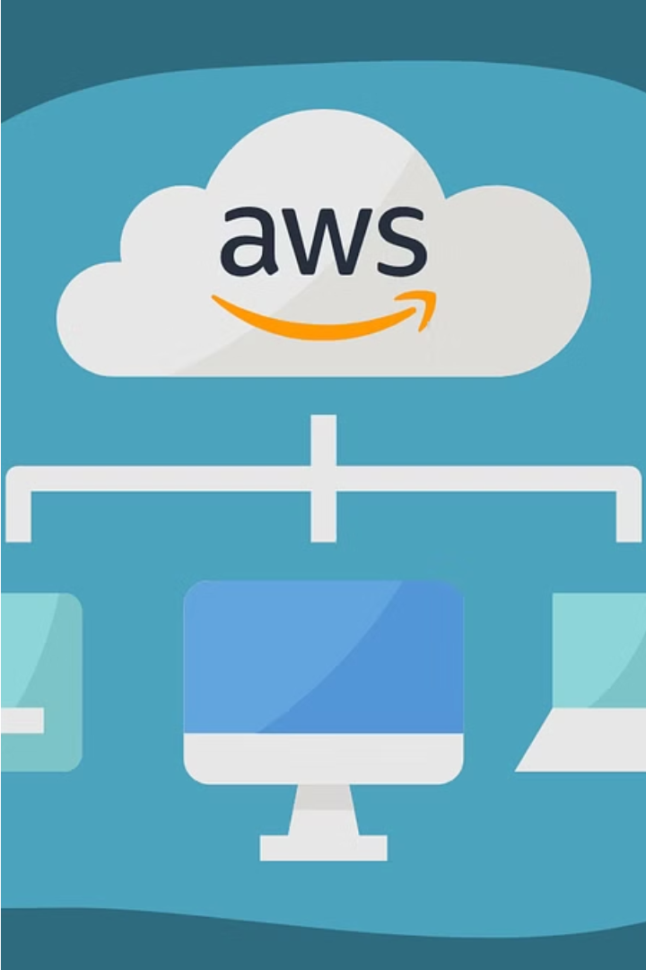
Leveraging AWS Services
Enhance your IT infrastructure and software development with the powerful suite of Amazon Web Services (AWS). Unlock the potential of scalable, reliable, and cost-effective cloud computing solutions.
Shubham Singh Soragi

Slide 2
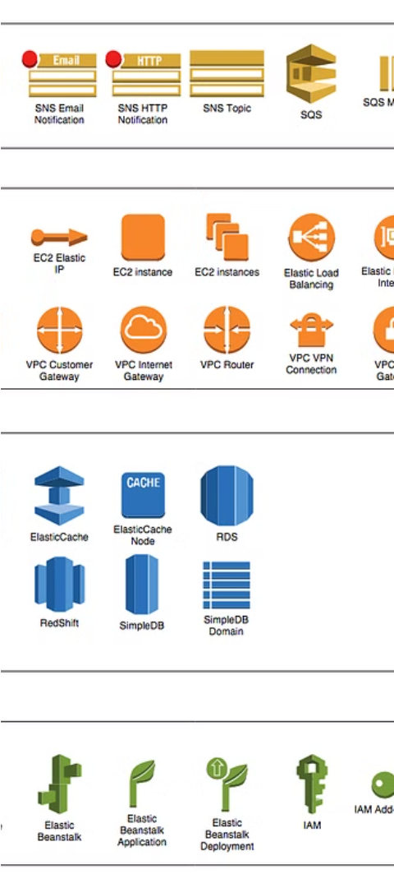
Introduction to Amazon Web Services (AWS)
Cloud Computing Platform
Global Infrastructure
AWS is a comprehensive, on-demand cloud computing platform that provides a diverse suite of services for computing, storage, networking, and more.
With data centers across the world, AWS offers global reach and low-latency access to its services, enabling businesses to scale their applications globally.
Wide Range of Services
From EC2 for compute, S3 for storage, to specialized services like machine learning and serverless computing, AWS offers an extensive portfolio to meet diverse business needs.

Slide 3
AWS Database Services
Amazon RDS
Amazon DynamoDB
Amazon Aurora
Amazon Relational Database Service (RDS) is a fully-managed database service that simplifies database setup, operations, and scalability. It supports popular engines like MySQL, PostgreSQL, and Oracle.
Amazon DynamoDB is a fully-managed NoSQL database service that provides fast and predictable performance with seamless scalability. It is ideal for applications that need low-latency data access at any scale.
Amazon Aurora is a relational database service that combines the performance and availability of high-end commercial databases with the simplicity and cost-effectiveness of open-source databases. It is highly scalable and reliable.

Slide 4
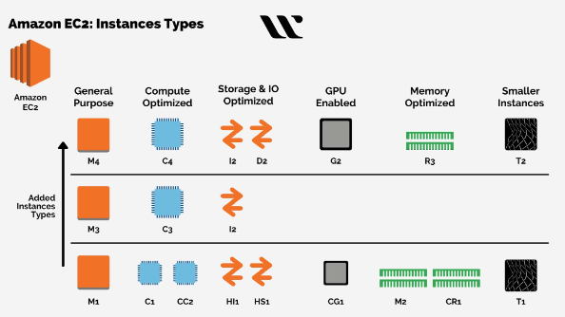
Amazon EC2 (Elastic Compute Cloud)
Amazon EC2 is a secure and scalable cloud computing service that lets you easily launch and manage virtual servers, called EC2 instances, to run your applications. You can choose the appropriate resources, such as CPU, memory, and storage, to match your application requirements.

Slide 5

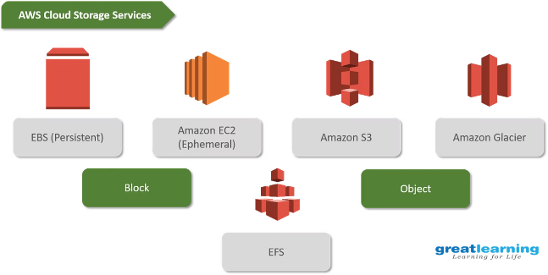
Amazon S3
Amazon S3 is a scalable storage service provided by AWS. It's designed for storing and retrieving data, from images to backups, with reliability and cost-effectiveness. With multiple redundant copies of data and different storage classes, it's a versatile solution for various use cases.

Slide 6
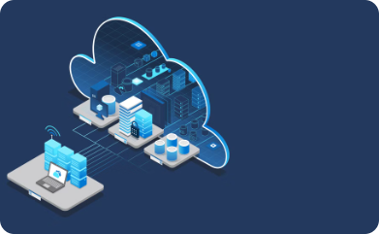
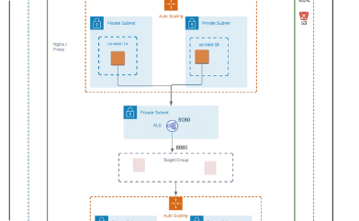
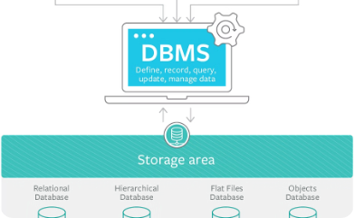
Amazon RDS
Managed Database Service
Scalable and Highly Available
Simplified Database Management
Amazon RDS simplifies the setup, operation, and scaling of relational databases in the cloud. It supports popular engines like MySQL, PostgreSQL, and Oracle.
RDS handles database provisioning, patching, backups, and recovery. It offers auto-scaling and high availability features for data security and accessibility.
The RDS console provides a user-friendly interface to manage all aspects of your database. It streamlines administration tasks, reducing the need for expertise.

Slide 7
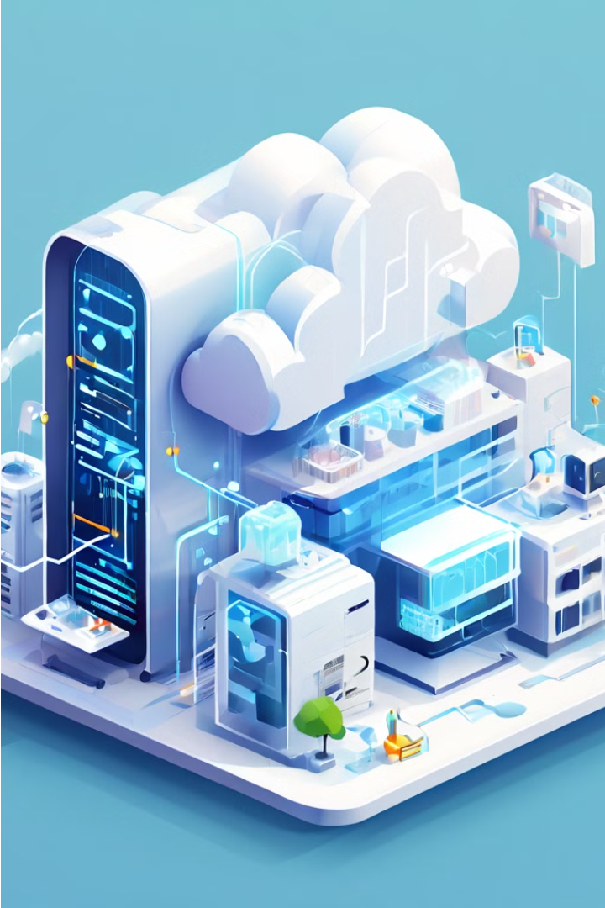
Amazon VPC (Virtual Private Cloud)
Amazon VPC (Virtual Private Cloud) is a secure and isolated virtual network within the AWS cloud. It allows you to control your network settings, including IP address ranges, subnets, and route tables, providing a private and customizable computing environment.
With Amazon VPC, you can easily create and manage your own virtual network, connecting it to your on-premises infrastructure or the internet, and control access to your resources through security groups and network access control lists (ACLs).

Slide 8
AWS IAM
1
Secure Access Management
2
User and Role Management
Control access to AWS resources and actions.
Create and manage users and roles with specific permissions.
3
Centralized Security
4
Audit and Compliance
Manage security credentials and permissions across your AWS environment.
Track access attempts and actions for auditing and compliance.

Slide 9
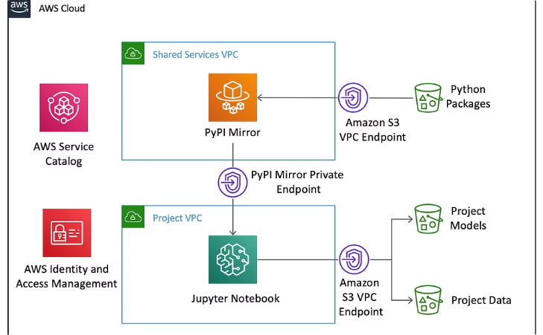
Amazon SageMaker
Build, train, and deploy machine learning models easily with Amazon SageMaker. It simplifies the process of creating sophisticated AI applications.

Slide 10
AWS Lambda
1
Serverless Computing
2
Event-Driven Architecture
3
Cost Optimization
Run code without managing servers and let it automatically scale with traffic.
Trigger functions with AWS services for real-time, scalable applications.
Pay only for compute time used, saving costs for intermittent or unpredictable workloads.

